Slide 1

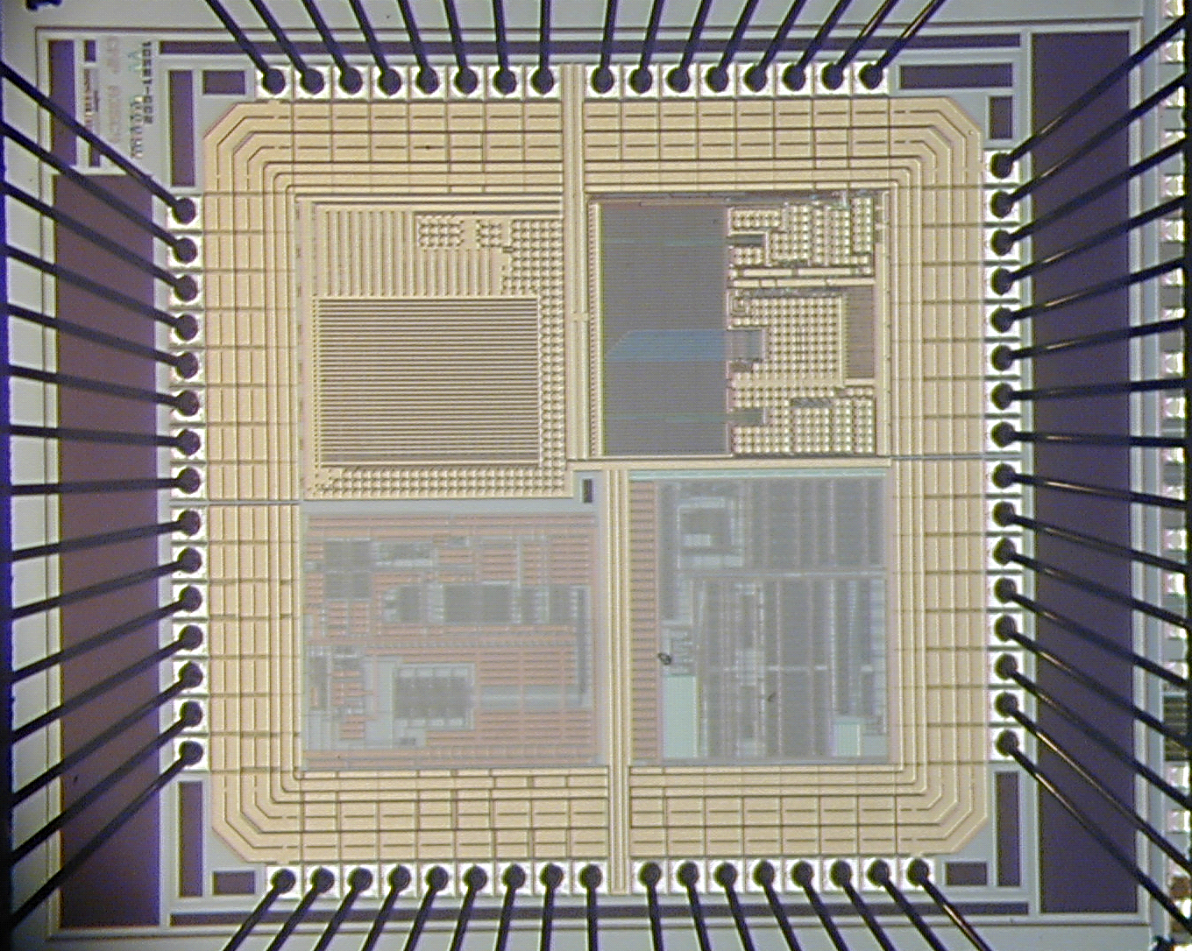
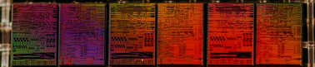

ADMISSIONS Fall 2021
2 Year MS Electrical Engineering in
Integrated Circuits (IC) and Systems
“A training from Idea to Product Design”
Department of Electrical Engineering at FAST-NUCES offers a MS program with expertise in Integrated Circuits and Systems . This is a first and
most mature MS IC design program in Pakistan, each student in this program will do the real-world tape out from project conception to the working silicon microchip under the guidance of faculty supervisor from university and industry experts
WHY INTEGRATED CIRCUITS (ICs) DESIGN ?
PROGRAM AND COURSES OUTLINE
Pivotal in 21st century technology trends; e.g. 5G, AI, and IoT systems.
High demand for skilled IC designers in global > 360 Billion $ industry.
More than four IC Design Startups in Pakistan.
Recent IC design center established in the Public Sector Organizations.
Huge demand of skilled IC designers in China and Far East.
Output tapped from each SC stage
WHY from FAST NUCES ?
Pioneer of IC design program in Pakistan.
Established collaboration with public and private industrial partners.
25 fully industrial funded MS students already enrolled in Spring-2020 will tape-out 8 group projects on two ICs in Spring-2021.
An established theoretical and experimental program with a hands on experience of conceptualization to end product IC design process.
Fully developed ICD lab with four full time faculty members with degrees in IC design and cumulative experience of over a dozen IC tapeouts.
An opportunity to learn modern IC design technique from experts.
Introduction and experience design experience on licensed Cadence tools suite (Worth: US$ 35000/-) and advanced 65nm, 130nm, and 180nm process development kits (PDKs).
Bright prospect of placement in public and private organizations after MS completion.
Tapeout Projects (Session-2020)
Gp-1: Logic Family for Self-Powered ASICs
Gp-2: Fault Tolerant CLB Design
Gp-3: 28-32 GHz LNA for 5G NR applications
Gp-4: mm Wave Phase Shifter for massive MIMO application
Gp-5: MMIMO Channel Estimation with ΣΔ ADC
Gp-6: Capacitor Less High Efficiency Triboelectric Energy Harvester
Gp-7: ASIC Implementation of ALU based Approximate Computing
Gp-8: True Random Number Generator for 5G NR
Student
Gp-1
Student
Gp-2
Student
Gp-3
Student
Gp-4
Student
Gp-5
Student
Gp-6
Student
Gp-7
Student
Gp-8
ELIGIBILTY
Fellowships
Teaching and Technical Staff
Output tapped from each SC stage
Output tapped from each SC stage
Engr.Sidra Saeed Design Engineer
MS EE (IC Design) FAST, NUCES, ISB.
Output tapped from each SC stage
Output tapped from each SC stage
Prof. Dr. Rashad Ramzan
Professor & Director RFCS² Lab
FAST, NUCES, ISB.
http://isb.nu.edu.pk/rfcs2/team_files/CV_Rashad_06_Dec_2020.pdf
Dr. Hassan Saif
Asst. Professor at
FAST, NUCES, ISB.
http://isb.nu.edu.pk/rfcs2/team_files/Hassan%20Saif%20FAST%20Lab%20CV.pdf
Output tapped from each SC stage
Bachelor in
Elect./ Electronics Engineering
Computer Engineering
Telecommunication Engineering
Mechatronics Engineering
Multiple Fellowships Available with Full or Partial Tuition Fee Wavier for Excellent performance or Financial Needs
Tuition fee 250K Rs/ 2-Years (Approx.)
Engr.Hamza Atiq Design Engineer
MS EE (IC Design ) FAST, NUCES, ISB.
Output tapped from each SC stage
PROGRAM DETAILS
HOW TO APPLY
For more details about MS IC design and our research group please visit http://isb.nu.edu.pk/rfcs2/
Contact: hassan.saif@nu.edu.pk , hamza.atiq@nu.edu.pk
Apply Online at http://admissions.nu.edu.pk/
or visit https://www.nu.edu.pk
School of Electrical Engineering

